Slide 1
Microservices Introduction

Slide 2
Topics
Cloud Native
Twelve Factor App
Microservices principles
Microservices design patterns
Demerits of microservices

Slide 3
What is Cloud Native?
A software approach of building, deploying, and managing modern applications in cloud computing environments.

Slide 4
How does a cloud-native approach benefit businesses?
Increase efficiency
Along with agile practices like DevOps and continuous delivery (CD).
Build scalable applications rapidly.
Reduce cost
No need to invest in the procurement and maintenance of costly physical infrastructure.
This results in long-term savings in operational expenditure.
Also benefits your clients.
Ensure availability
Build resilient and highly available applications.
Feature updates do not cause downtime.
Companies can scale up app resources during peak seasons to provide a positive customer experience.

Slide 5
Cloud Native Apps vs Traditional Enterprise Apps
Cloud Native Applications | Traditional Enterprise Applications
Uses less flexible software development methods | Uses a collaborative approach
Longer time to deploy | Automated deployment
Not scalable | Highly scalable
OS dependent | OS independent/abstract

Slide 6
Terminologies
Cloud computing
Refers to software infrastructure hosted on an external data center and made available to users on a pay-per-use basis.
Companies don't have to pay for expensive servers and maintain them.
Instead, they can use on-demand cloud-native services such as storage, database, and analytics from a cloud provider.
Cloud computing compared to cloud native
Cloud computing is the resources, infrastructure, and tools provided on-demand by cloud vendors.
Meanwhile, cloud native is an approach that builds and runs software programs with the cloud computing model.
Cloud-enabled
Cloud-enabled applications are legacy enterprise applications that were running on an on-premises data center but have been modified to run on the cloud.
This involves changing part of the software module to migrate the application to cloud servers.
Cloud native compared to cloud enabled
The term cloud native refers to an application that was designed to reside in the cloud from the start.
Cloud native involves cloud technologies like microservices, container orchestrators, and auto scaling.
A cloud-enabled application doesn't have the flexibility, resiliency, or scalability of its cloud-native counterpart.
This is because cloud-enabled applications retain their monolithic structure even though they have moved to the cloud.

Slide 7
Twelve Factor App
A set of 12 principles or best practices for building web applications.
Web Applications now days are more commonly known as Software-As-A-Service (SAAS) applications.
It was published by the co-founder of Heroku, Mr. Adam Wiggins in 2011.
Help create applications that use declarative programming for automation of setup.
In turns reduces the development time and cost of the projects.
Benefits
doesn’t rely on any particular OS
easily portable
highly suitable for deployment on cloud
allows continuous deployment
easily horizontally scalable without requiring many changes in the codebase.

Slide 8
The Twelve Factors
1. Codebase
Single codebase per application tracked in version control with many deploys.
In naive terms, a codebase is all the human-written source code that doesn’t include the class or object files generated by the tools.
A deploy refers to a single running instance of that particular application.
Each application must have only a single codebase.
Each such codebase must be managed in a version control system.
Some popular VCS (Version Control System) includes git, svn and mercurial.
It there exists multiple codebases, then it’s not an application, it’s a distributed system.
Each component of that system will be known as an application that shall follow the principles of the 12-factor apps.
2. Dependencies
Explicitly declare and isolate dependencies.
The task of managing the dependencies is given to the developer.
Always declare the dependencies in the manifest file, a file containing the metadata for the dependencies like name, version.
It increases the speed of the development as the developer is free from the task of managing the correct version of the libraries.
There is no need for explicitly downloading the required JARs anymore.

Slide 9
The Twelve Factors - contd
3. Config
Store config in the environment.
The source code and the configurations must be completely separated from each other.
Application’s configurations vary from environment to environment like dev, test, prod, etc.
Store all the configurations like DB credentials, path, URI for each environment in separate configuration file.
4. Backing Services
Treat backing services as attached resources.
Any service that your application consumes over the network is known as a backing service.
Your application must treat these services as resources which it is consuming over the network.
These resources should easily attach or detach from your application dependeing on the environment.
A simple example is supposed your application is currently using a local PostgreSQL database for its operations and it is afterward replaced with the one hosted on the server of your company by just changing the URL and the database credentials.

Slide 10
The Twelve Factors - contd
5. Build, Release and Run
Strictly separate built and run stages.
The deployment of your application must be properly separated into three non-overlapping non-dependent phases namely build, release and run.
The build phase constitutes the compilation of the code which in the end generates the artifact like a JAR or WAR file.
The second phase, release, take the artifact file generated at the end of the previous phase and adds the configurations for a particular environment to it.
The last phase includes the running of the instance of the application.
6. Processes
Execute the application as one or more stateless processes.
An application is said to follow this principle if its instances can be created and destroyed any time without making any effect on the overall functionality of our application.
To achieve and fulfill this principle, our application must store any type of data generated by it in any persistent (stateful) datastore.
But it doesn’t mean that we can’t use the in-memory of the processes of our application. We can use it to store as temporary storage.

Slide 11
The Twelve Factors - contd
7. Port Binding
Export services via port binding.
Any application that follows this principle is completely self-contained and standalone.
It exports HTTP as a service and doesn’t require any server like a tomcat to listen to requests.
It binds itself to some particular port and listens to all the requests hitting on that port.
8. Concurrency
Scale out via the process model.
An application that follows this principle must be divided into smaller different processes instead of a single large application.
Each such process must be able to start, terminate and replicate itself independently and at any time.
This principle allows scaling our application very easily.
By scaling out we refer to horizontal scaling in which we run multiple instances of our processes.

Slide 12
The Twelve Factors - contd
9. Disposability
Maximize robustness with fast startup and graceful shutdown.
Robustness of an application refers to the graceful starting and termination of its processes without affecting the overall application’s functionality.
For example
One of the processes of our application is storing the details of a newly added employee to the company into a database.
But while doing so, in between an unexpected error occurs which causes the process to terminate in between unexpectedly.
However, the state of our application or database must not be affected by it and the process must fail-safe.
Also, it must start quickly whenever required.
10. Development/Production Parity
Keep development, staging, and production as similar as possible.
It simply means that the development and production environment must be as similar as possible.
The processes being used, technologies and the infrastructure must be the same.
This will help you in a way that whatever error that can happen over time will happen at the development stage itself instead of surprisingly occurring in the production.

Slide 13
The Twelve Factors - contd
11. Logs
Treat logs as event streams.
Logs are very essential to understand the internal working of the application
It can be of different levels.
Generally stored in a file named “logFile” in the storage.
Whenever a request enters into the system, corresponding logs are made and they are treated as a sequence of events that can be used to debug when some problem occurs.
12. Admin Processes
Run admin/management tasks as one-off processes.
Most of the applications require a few one-off tasks to be executed before the actual flow of the application starts.
These tasks are not required very often and hence, we generally create a script for it which we run from some other environment.
On the other hand, the twelve-factor methodology says that such scripts must be made a part of our codebase itself managed in the version control system.
These tasks should also follow twelve-factor principles.

Slide 14
Microservices Design Principles
Top 10 Microservices Design Principles
Independent and Autonomous/Self-governing services
API aggregation
Flexibility
Scalability
Constant monitoring
Failure Isolation/ Failure resilience
Realtime Load balancing
Inclusion of DevOps
Versioning
Availability

Slide 15
Microservices Design Principles - contd
Independent and Autonomous/Self-governing services
Self contained
Operate Independently
Develop, Test and Deploy Independently
API aggregation
No Programming language barrier
Inter services communication
Flexibility
To Change or be changed easily
Scalability
Application to get modified according to the increasing or decreasing traffic, data, and complexity without affecting the performance of the system.
Ways - Load balancing, Horizontal scaling, and Caching.

Slide 16
Microservices Design Principles - contd
Constant monitoring
Constant monitoring is required so that the faults can be resolved at the earliest and your application can run smoothly.
Achieved by - Logging and metrics, Distributed tracing, Health checks, Alerting and notifications
Failure Isolation/ Failure resilience
Helps to minimize the impact of failures on the whole system due to the failure of a particular system.
Achieved by – Circuit Breakers, Include Redundancy, Graceful shutdown
7. Realtime Load balancing
8. Inclusion of DevOps
9. Versioning
10. Availability

Slide 17
Microservices Design Patterns
Some of the more important patterns:
Service Registry
Circuit Breaker
API Gateway
Event Driven Architecture
Database per Service
Externalized Configuration

Slide 18
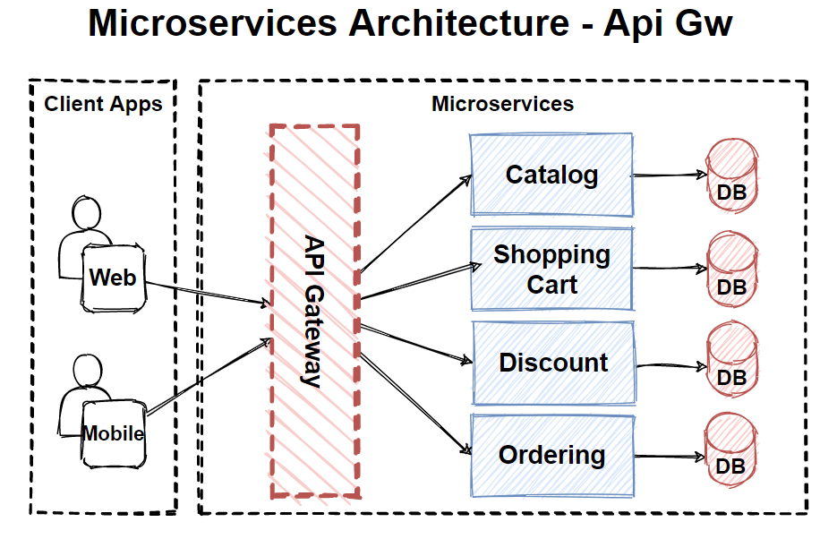
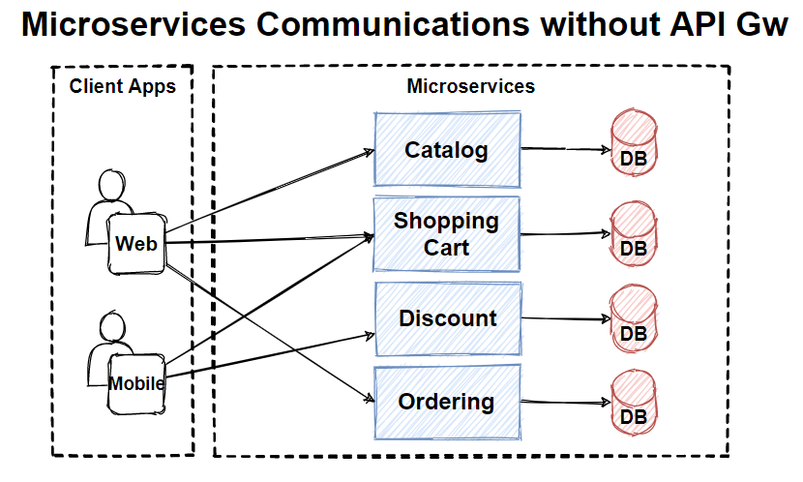
API Gateway Pattern
A single point of entry for clients to access the application's services

Slide 19
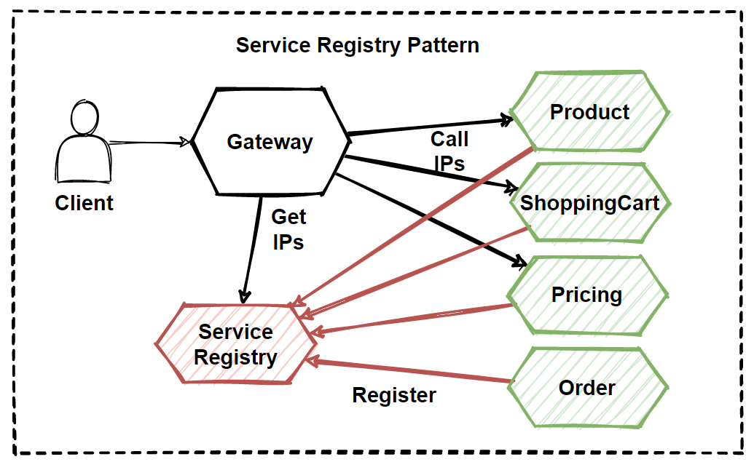
Service Registry Pattern
Keeps track of all the services in your system.
Makes it easier to find each other.
Every service needs to register itself with the service registry when it starts up, and deregister when it shuts down.
Other services can then query the service registry to locate the services they need to interact with.

Slide 20
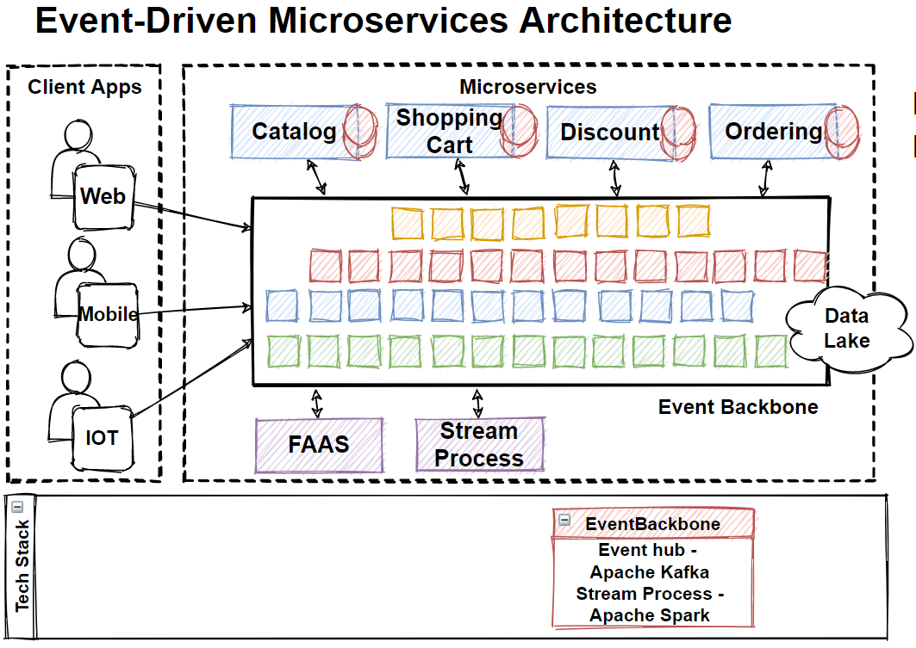
Event Driven Pattern
When a service performs an action that other services need to know about, it emits an event—a record of the action.
Other services then react to the event as necessary.
This is a powerful way to decouple services.
Allows for highly scalable and robust systems.

Slide 21
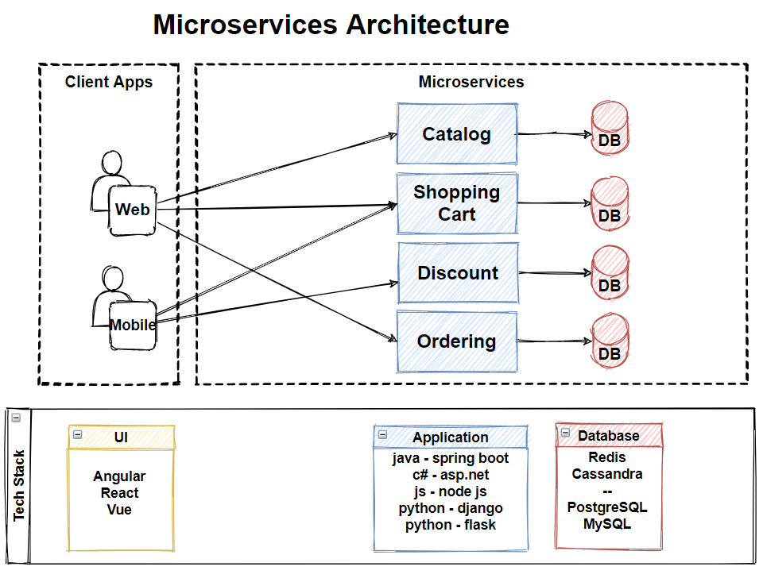
Database per Service Pattern
In a traditional monolithic application, you would have a single database that all services interact with.
However, in a microservices architecture, each service has its own database.

Slide 22
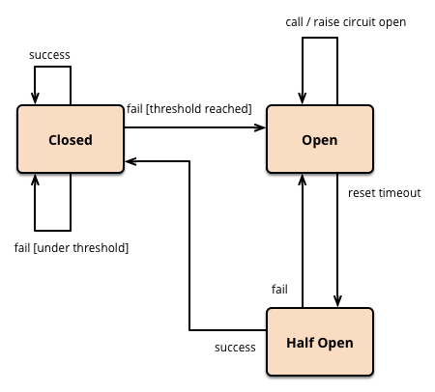
Circuit Breaker Design Pattern
Used when a service is exhibiting high latency or is completely unresponsive.
Three states :
Open: When the number of failures has exceeded the threshold.
Closed: Default state and all calls are responded to normally.
Half-open: Checking for underlying problems.

Slide 23
Demerits of Microservices
Despite the many advantages of microservices, they aren’t always the best choice for every organization.
Before committing, you’ll want to make sure that a microservices migration aligns with your organization’s culture and business objectives.
The first step in determining if microservices is the right fit is evaluating the challenges you’ll likely face during the transformation.
From there you will need to figure out whether your team is equipped to handle them.
Few disadvantages of using a microservices architecture are:
Being more complicated than most monolithic applications
Requiring cultural changes
Often are more expensive than monoliths
Can present security threats

Slide 24
END

